Slide 1
Festival of Food Information Pack
Saturday 14 May 2022

Slide 2
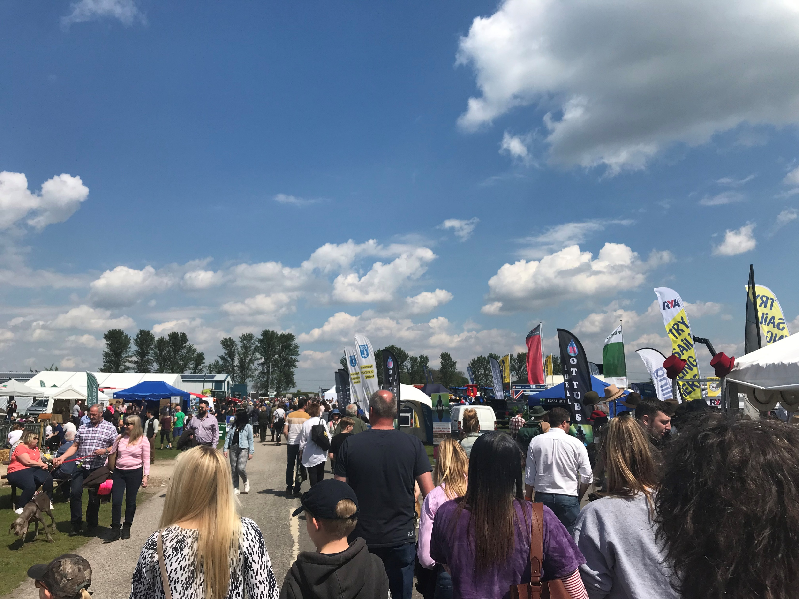
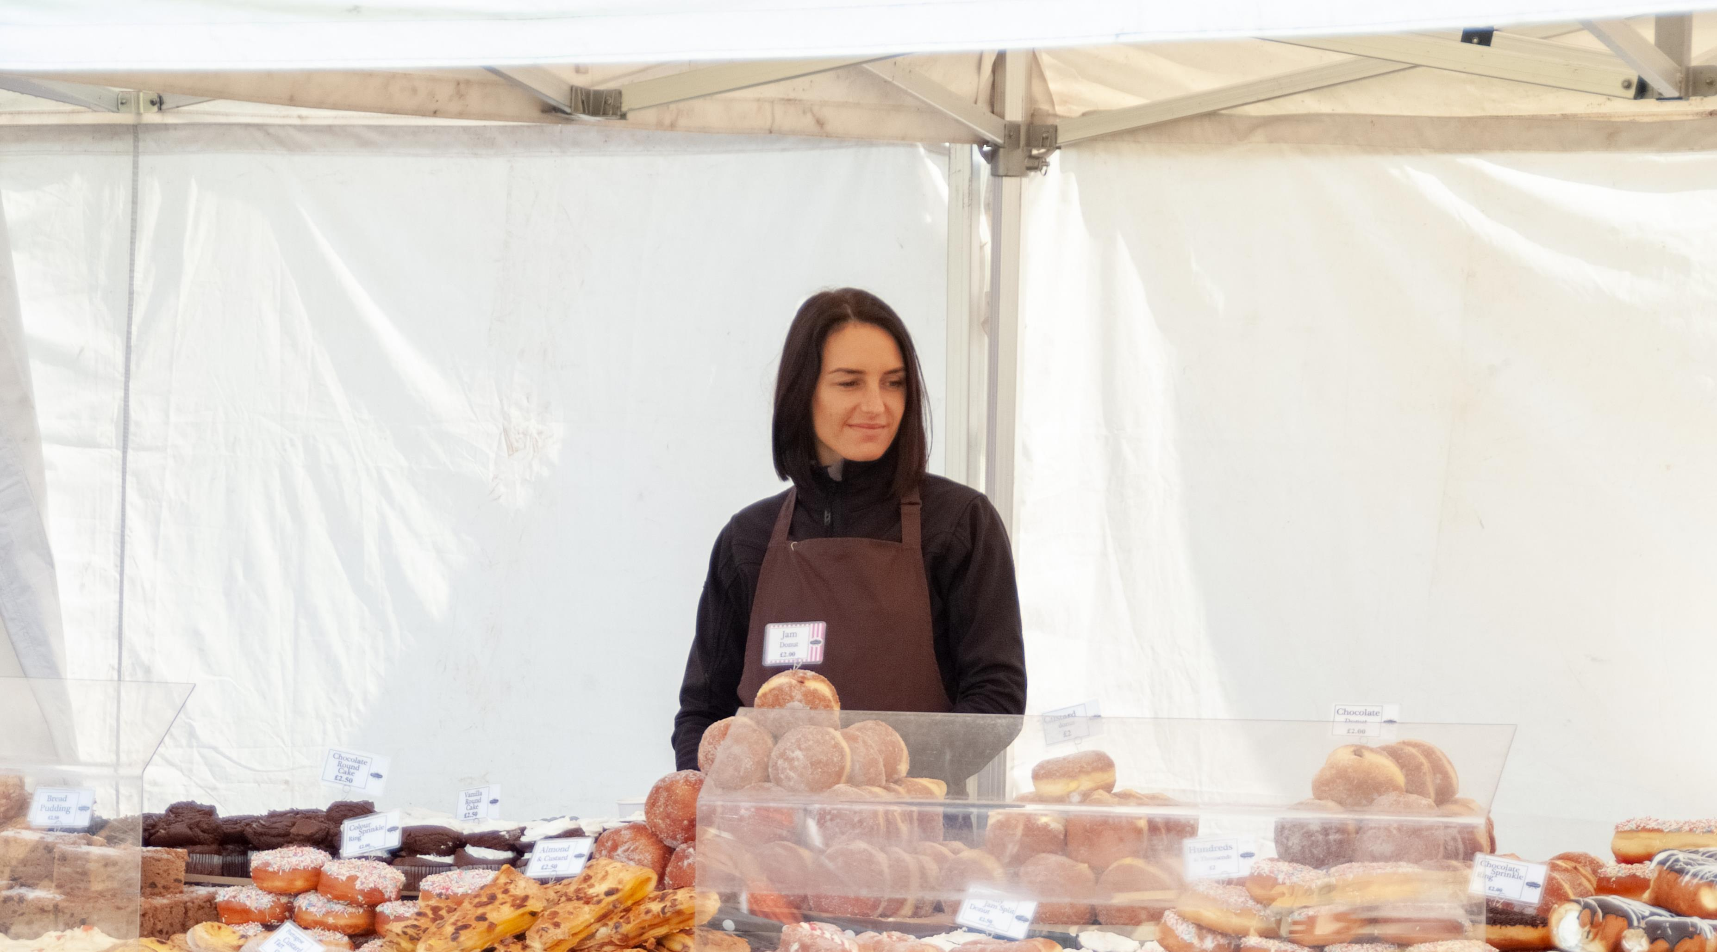
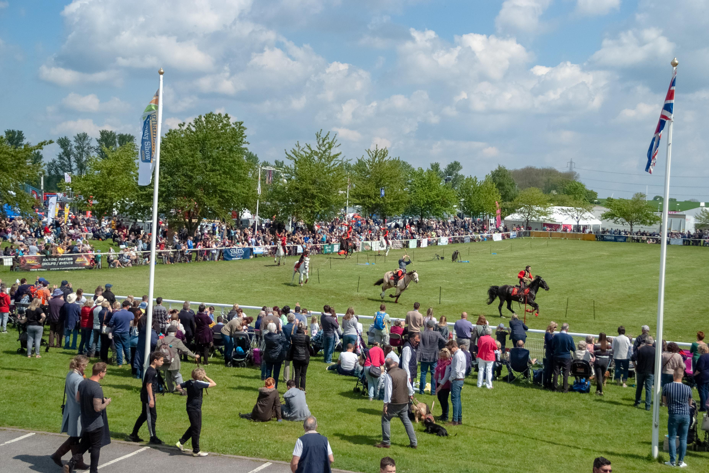
Nottinghamshire County Show 2022
Visitors will be looking to experience the best of farming, countryside and rural life.
As the first county show of the season, it’s always a highlight in the summer events calendar. And this year’s shaping up to be another brilliant show with 1000s of visitors expected to attend from Nottinghamshire, Lincolnshire, Leicestershire, Rutland, Derbyshire, South Yorkshire and beyond.
Will you join us to showcase your business and meet lots of potential customers?
Why take a stand?
Competitively priced food and drink stands - an affordable way to promote your business
New for this year – introductory offer for Nottinghamshire Local Food Producers to give our visitors a flavour of the County.
Showcase your latest products and services
Outdoor and covered trade stands available
Purpose-built grounds on free-draining sand-based soil
Excellent facilities to make sure your show goes without a hitch
Dedicated food and drink area and tutorials offering demonstrations and a range of stands aiming to raise the profile of the quality food produced in Great Britain
Promotion on our marketing channels including web and social media
All trade stands are entered free of charge into our Trade Stand Competition.
Maximise the opportunity.
Apply early to make sure your company details are published on our website - a proven source of post-show sales.
128,222 page views
4897 followers

Slide 3
Booking your stand
You will need to provide important documents
Our booking system enables you to upload documents like Public Liability Insurance Certificates and risk assessments so have these ready before you start your booking. Ideally you will already have risk assessments to cover your attendance at the show, however we can provide a template if you don’t have one. Useful information on completing risk assessments can be found at www.hse.gov.uk/simple-health-safety/risk/
Showing Scene – our online booking system
Showing Scene is our online booking provider. They cover lots of other shows and events so if you already have an account with them you can use the same login details to book your stand with us. If you don’t have an account, one can be created when you do your booking. The trade stand booking form is on one page, all you need to do is scroll down or up to fill in the form.
Accurate contact information
We like to share important information with you before the show as well as list you on our website. So please make sure we have the correct trading name, contact name/s and email address/s on the booking form. A secondary contact can also be included in your booking.
Stand sizes
We have a range of stand sizes starting from 3m x 3m. Start by reviewing the stand plan and choosing the best size and location for your company. If you can’t find what you are looking for, then please call the office. 01636 705 796.
Submit Your Booking
Once your booking has been submitted it will be reviewed by the Show Office. Bookings will be declined or confirmed by email through Showing Scene, so please look out for them in your inbox.
Invoices and Payment
The email confirming your booking will also have your invoice attached and a link to pay for you stand by card. Payments can also be made by BACS or cheque. Your stand will not be reserved until we receive payment in full.
This booklet contains lots of other information, rules and regulations but please call us if you have any questions, 01636 705796

Slide 4
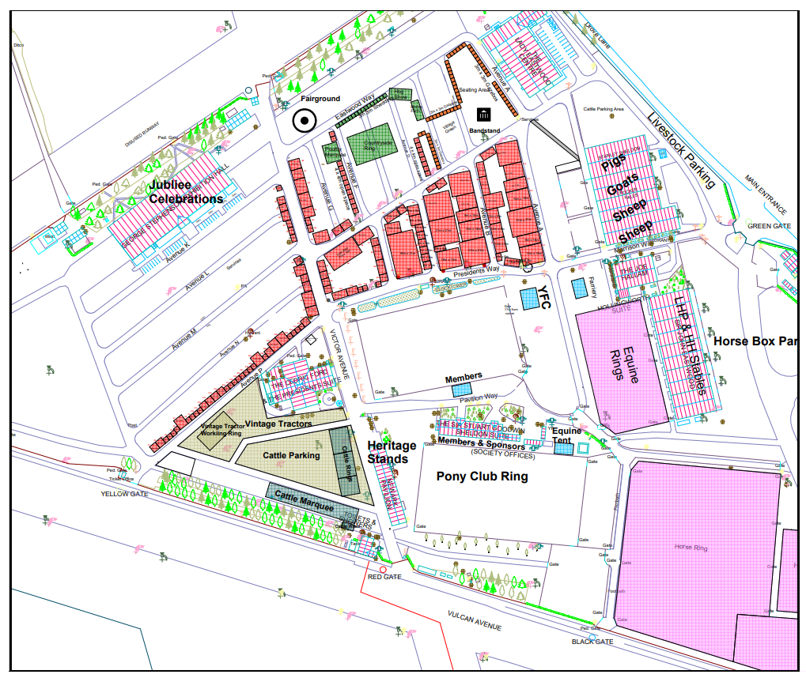
2022 layout of Food and Drink Stands
Festival of Food
The food and drink stands are situated within the Village Green area with bandstand and live music, traditional village games and casual outside seating areas

Slide 5
INDEX
IMPORTANT DATES
Closing Dates for:
Stand Bookings - Friday 1st April 2022
Water Applications - Friday 1st April 2022
Electricity Applications - Friday 29 April 2022
Other Dates to Note:
Earliest access for setting-up your stand -12 noon Thursday 12 May 2022
Latest date for clear-down after Show - 12 noon Sunday 15 May 2022
Stand bookings can be made quickly and easily at www.nottinghamshirecountyshow.com
SECTION 1 – APPLICATION FOR SPACE Page 6 - 7
1.1 Stand Charges
1.2 Closing Dates
1.3 Application for Space
1.4 Cancellation of Space Booked
1.5 Charities
1.6 Tables and Chairs
1.7 Description of Exhibits in Show Publication
1.8 Recovery of Fines, Fees and Charges
1.9 Guidelines for New Traders
SECTION 2 – TICKETS, PASSES & ACCESS TO THE SHOWGROUND Page 8
2.1 Definitions
2.2 Exhibitors Complimentary Admission Tickets/Wristbands
2.3 Additional Show Tickets/Wristbands for Exhibitors
2.4 Exhibitor Vehicle Passes
SECTION 3 – SHOW REGULATIONS Page 9 - 11
3.1 Exhibition of Livestock on Stands
3.2 Noise
3.3 Raffle Tickets, Collections and Appeals
3.4 Advertisements
3.5 Prohibited Activities
3.6 Ground Conditions
3.7 Painting and Varnishing
3.8 Security
3.9 Health and Safety
3.10 Litter
3.11 Underground Services
3.12 Unoccupied space
3.13 Vehicles
3.14 Site Services
SECTION 4 – SHOW REGULATIONS Page 12
4.1 Set Up and Dismantling of Trade Stands
4.2 Encroachment
4.3 Mobile Units
4.4 Delivery to Stands
4.5 Time of Dismantling/ Removal of Trade Stands

Slide 6
SECTION 1 -APPLICATION FOR SPACE AND COST
Rates are for the show day plus VAT
PLEASE NOTE THAT ALL FOOD and DRINK STANDS ARE ON OPEN GRASS SITES
The Food and Drink (England) Regulations 2006 and associated legislation make it an offence for anyone to sell, process or offer food which is harmful to health. They also place the obligation on businesses to ensure food is prepared and sold in a hygienic way
All food and drink exhibitors must be registered with their local authority for Food and Hygiene regulations.
All companies selling alcohol, must obtain a TEN licence which must be sent to the show office by 22nd April 2022
Stands for Take-Home food and drink (not consumed on the day) | 3m x 3m | 6m x 3m
Open Space Clear grassed area for your stand | £96.00 | £192.00
Covered Stands Open fronted gazebos to put you stand inside | £210.00 | £420.00
Nottinghamshire Local Producer This is an introductory offer to Nottinghamshire Local Food Producers who will offer our visitors a flavour of Nottinghamshire. Only companies based in Nottinghamshire qualify. Open space only. | £60.00
Stands for catering - food and drink consumed on the day | 3m x 3m | 6m x 3m
Open Space Clear grassed area for your stand | £250.00 | £450.00

Slide 7
1.2 Closing Dates
In order for information regarding your stand to be entered onto the Show Map we must have received a full application and payment by Friday 1st April 2022.
1.3 Application for Space
Applications are to be made in full through our secure online booking system including submitting an up to date Food Hygiene Certificate, Risk Assessment and a copy of your Public Liability insurance. The link to the booking system can be found on the website: https://www.nottinghamshirecountyshow.com/exhibitors/
Any exhibitor handling food items must be registered with their local authority for Food & Hygiene regulations and these regulations must be complied with.
All online applications will be subject to authorisation. The Society reserves the right to refuse application, without giving any reason and reserves the right to determine the area and position of sites.
No goods other than those stated on the Application Form may be displayed or sold without prior approval of the Society. The Society reserves the right to veto any exhibit or part thereof at any time. The Society’s decision is final.
1.4 Use of Space
Exhibitors must comply with all relevant Trading Standards legislation – safety, fair trading and quality. Trading Standards representatives do attend the show. We will encourage the consumer to forward any complaints to the Trading Standards Office.
Exhibition space will be clearly marked out on the ground. Your stand MUST fit into the area you have booked and marked out by us, including any vehicle guy-ropes and trailer drawbars. Exhibitors must not arrange goods or signs that create an obstruction to other exhibitors or the free flow of visitors.
Sub-letting or allowing another exhibitor to occupy part of your stand is forbidden. Any stand found to be infringing this rule will be asked to close down and cease trading.
Traders who send a representative to set up their stand must ensure they have all the necessary documentation and passes required or they will be refused entry.
It is the exhibitors responsibility to ensure that any construction of marquees or any other structure complies with the regulations stated in 2015 Construction (Design and Management) rules. Marquees must be offsite by 5pm Monday, 16th May.
The Society reserve the right to decline any trader it views to be selling items they deem to be unacceptable or offensive and any product that could be a nuisance or annoyance to others.
Charities - please note that there are a limited number of sites available for charities which will be allocated at the Society’s discretion. The Charity
Registration number is required as proof of status. The Society may refuse any Charity whatsoever without reason.
1.5 Cancellation of space reserved.
Cancellations must be notified in writing. The Society reserves the right to re-let any cancelled space. For cancellations received before Friday 1st April 2022, an administration fee of £65.00 plus VAT will be deducted from any refund. The payment of refunds in respect of the cancellation of trade space will be at the discretion of the Society.
PLEASE NOTE - For cancellations received after Friday 1st April 2022, no refunds whatsoever will be given in respect of cancellation of space reserved.
Should the show be cancelled due to Covid regulations, a full refund will be applied.
1.6 Tables and Chairs
1.8m trestle tables and chairs are available free of charge. Tables and chairs will be available and stacked in different locations around the showground for exhibitors to use. Breakages will need to be paid for.
1.7 Description of Exhibits in Show Publication
Each exhibitor must complete the Description section of the Application Form and will receive, free of charge, an entry on the Show Website. The listing will display Name, Stand Number and Website together with up to 30 words of descriptive matter. Exhibitors will not be allowed to sell or demonstrate goods which have not been included in their catalogue description unless prior permission is granted.
1.8 Recovery of Fines, Fees and Charges
Any fines, fees and charges shall be recoverable by the Society and, until payment is made, persons owing them shall be debarred from exhibiting at future Shows of the Society.
1.9 Guidelines for New Traders
The siting of new traders will be at the discretion of the Society who will endeavour to accommodate any requests.
New traders must submit a colour photograph of their trade stand and their website address.
You will be allocated a Trade Stand Number at least two weeks before the Show and your designated area will be highlighted on the plan sent to you with your tickets.
During the set-up days and the show day the Trade Stand Information/Booking-in Office will be located at Blue Gate.

Slide 8
SECTION 2 – TICKETS, PASSES AND ACCESS TO THE SHOWGROUND
PLEASE NOTE: Due to the number of businesses not receiving their passes, trade packs will no longer be sent in the post. Packs will be collected on arrival at Blue Gate during show set up times.
2.1 Timings
The Show opening times are 09:00 until 17:00.
(a) Pre-Show Period – Thursday 12 May 12:00 – 19:00, Friday 13 May 8:00 – 19:00, Saturday 14 May – 06:30 – 08:30.
(b) Show Period – Saturday 14 May 08:30 – 18:30.
(c) Post Show Period – from 18:30 Saturday 14 May until 12:00 Sunday 15 May.
2.2 Exhibitors Complimentary Admission Wristbands
Wristbands must be worn for set-up and the show day and will be checked by security on entry to the showground. Exhibitors will receive the following number of Exhibitor weekend wristbands based on the size of the trade stand booked:
2.3 Additional Show Wristbands for Exhibitors
Additional wristbands for exhibitors and their guests, over and above the free allocation, may be purchased at a cost of £10.00. Additional wristbands can be purchased at this price until Friday 6 May 23.59 hours. Extra day tickets required after this date can be purchased through our online ticketing system at £14 each.
2.4 Exhibitor Vehicle Passes
Vehicle access to the Showground is closely managed to minimise vehicle movement during the Show and improve public safety.
Please note that all Vehicle Passes must be affixed to vehicle windscreens prior to entering the showground. Failure to comply will mean no entry to the Showground.
Under no circumstances will refunds be made to exhibitors or their staff or representatives who arrive at entrances without correct passes and who have to pay the public price to gain admission to the Showground.
Static Vehicle Pass
All vehicles parked on the Showground must display a Static Vehicle Pass. This must be completed with full contact details, this includes all vehicles parked to the rear of the trade stand. Static Vehicle Passes purchased at the time of booking are at a discounted rate of £25 plus Vat. A £50 deposit system will be in operation for any vehicle that doesn’t have a Static Vehicle Pass, this will be refunded when exiting Green Gate BEFORE 08:30hours.The deposit will not be refunded to any vehicle exiting site after 08.30am.
b. Blue Gate Exhibitor Car Park Pass
All trade stand exhibitors will be allocated one Blue Gate vehicle pass which will allow parking in Blue Gate Exhibitors Car Park. They do not allow vehicle entry inside the showground. Additional Blue Gate Vehicle Passes must be requested before Friday 1st April 2022.
c. Set-up Day Vehicle Pass (Thursday / Friday only)
One pass per booking will be issued free of charge. They must be displayed to gain entry to the showground on set-up days.
Vehicle Passes do NOT admit Driver or Occupants to the Show. Exhibitor wristbands must be worn with Vehicle Passes. All vehicle occupants will be asked show their wristbands which must be worn at all times.
Area Booked | Number of Tickets allocated
Up to 16 sq. m | 2
17 – 36 sq.m | 3
36 - 72 sq. m | 4
Over 72 sq.m | 5 max
Stand bookings can be made quickly and easily at www.nottinghamshirecountyshow.com

Slide 9
SECTION 3 – SHOW REGULATIONS
3.1 Exhibition of Livestock on Stands
Exhibitors wishing to include livestock on their stands must first obtain the Society’s approval and an application to exhibit animals, including the hatching of eggs, must be received by the Society no less than 60 days before the Show with full details.
Animals exhibited on trade stands cannot exhibit in Show classes.
All livestock is subject to: (i) Movement control; (ii) Controls applied by DEFRA and any other authorities in relation to health status within DEFRA or other recognised scheme for a species; (iii) Declaration of disease-free certifications; and (iv) all livestock and birds must be accompanied by the appropriate documentation.
All livestock and birds are subject to the orders of DEFRA and local authorities, which may be operative at the time of the show.
Exhibitors are wholly responsible for obtaining all certificates and permits, including those required to leave the Showground at the end of the Show.
All livestock on trade stands must be halter led at all times. Such livestock must not be allowed to come into contact with any animals competing in the Show that are of a different health status.
No livestock may be removed from the competitive classes and housed on a trade stand either before or after judging of the class in accordance with the arrangements agreed between the Society and officers of DEFRA.
A competent stockman must attend animals on trade stands throughout the Show and this includes overnight. Exhibitors are responsible for the security of their stand and stock and all claims arising from this.
Exhibitors must, at all times, comply with any instruction or request made by the Society Veterinary Officer.
3.2 Noise
Exhibitors must not use any loudspeaker apparatus, or any other offensive noisy practices to cause annoyance in any way. Guidelines to minimise noise and the risk of hearing damage etc. may be obtained from the Health and Safety Executive. A risk assessment must also cover noise.
3.3 Raffle Tickets, Collections and Appeals
Raffle tickets may only be sold with the prior written consent of the Society and strictly within the stand space confines. Stands selling raffle tickets must be registered under the Lotteries and Amusements Act 1976. Written consent must be displayed on the trade stand. Games of Chance etc. will also need written consent to be displayed on the trade stand. The raffle of live animals is prohibited. Charities or other institutions wishing to make appeals for contributions to their funds must first obtain written permission from the Society. If permission is granted collections must not be made outside the limits of the trade stand.
3.4 Advertisements
No exhibitor or other person will be allowed to affix or distribute any placard, leaflets, publicity material or advertisement to any part of the Society’s plant or premises without the written permission of the Society. No exhibitor or other person will be allowed to distribute handbills or display advertisements except on their own stand. Show stewards have the right to confiscate any publicity material being distributed contrary to this regulation.
3.5 Prohibited Activities
a. Threatening and Intimidating Behaviour
Threatening and intimidating behaviour of any kind will not be tolerated and will result in that person/s being removed from the Showground.
b. Balloons and Kites.
The selling or donating of hand-held size inflated or deflated balloons and of kites is forbidden to avoid frightening livestock. The Society will not permit hand-held
Stand bookings can be made quickly and easily at www.nottinghamshirecountyshow.com

Slide 10
size balloon races to be organised from the Showground or car parks. The release of Chinese Lanterns is prohibited.
c. Aircraft Advertising, Loudspeaker Advertising, Trailing Banner Advertising.
Exhibitors are not allowed to advertise by means of aircraft, loudspeakers or trailing banners.
d. Knives, Imitation Weapons, Cap Guns, BB Guns, Laser Pens, Pea Shooters, Catapults and Explosive Devices.
The sale of cap guns, BB guns, laser pens, pea shooters, catapults and explosive devices is strictly forbidden. Any exhibitor found selling such items will be asked to leave the Showground and will not be invited to exhibit again at either the Newark Vintage Tractor & Heritage Show or the Nottinghamshire County Show.
Special authorisation for the sale of firearms, shotguns, air pistols etc., must be obtained from the following: Firearms Officer, Nottinghamshire Constabulary Headquarters, Sherwood Lodge, Arnold, Nottingham, Nottinghamshire NG5 8PP. A copy must also be sent to the Community Safety Co-ordinator at Newark & Sherwood District Council, Newark & Sherwood District Council, Castle House, Great North Road, Newark, Notts, NG24 1BY
e. Protests, Demonstrations, Deputations, Delegations and Canvassing of members of the Public other than within the confines of the exhibitor’s trade stand space.
f. Riding of Cycles, Motorcycles etc.
The riding of cycles, motorcycles, motor trikes, farm bikes, quad bikes, monkey bikes & motorised scooters etc. on the Showground, in the car parks or caravan areas is not allowed except by authorised Showground personnel.
3.6 Ground Condition
The Society will not be responsible for the ground condition of the sites offered and will not guarantee to make any modifications to such sites.
3.7 Painting & Varnishing
Any paint or varnish used in the set-up of your trade stand must be dry by 7.15 a.m. on the first day of the Show.
3.8 Security
Security will be in operation from Thursday 12 May until Sunday 15 May 2022.
There will be continuous night security patrols during the Show weekend but it is the responsibility of exhibitors or their agents to safeguard their property. The Society does not accept any responsibility whatsoever for any losses.
3.9 Health and Safety
All food and drink traders / catering stands must provide a Food Hygiene Certificate, Risk Assessment under the Health & Safety at Work Act. A template is available from the Show Team, please ask. The Risk Assessment document will be checked by our H&S team. Applications will be rejected if the Risk Assessment is considered inadequate. Applications can not be processed or authorised without these forms. Please retain copies for your records. All risk assessments must be available for inspection on your trade stand at the Showground if required. Exhibitors are reminded that they are responsible for the observations, by themselves, their employees and their contractors of all Health & Safety regulations and legislation. Health and Safety inspections will be made on the day.
Any exhibitor handling food items must be registered with their local authority for Food & Hygiene regulations and these regulations must be complied with.
All exhibitors must carry Public Liability Insurance to a minimum of £5M. A copy of the valid Certificate of Insurance must be submitted with your stand application as proof of evidence. Applications can not be processed or authorised without this certificate If your current Certificate is due to expire before the dates of the Show, then it is your responsibility to submit to the Show Office the copy of your newly issued Certificate of Insurance which will cover the dates of the Show. In all instances, we strongly recommend that you bring your Certificate of Insurance with you. Exhibitors must insure against fire, theft and other appropriate risks, not only as regards their property, but also against third party claims. Any firm or organisation employing people must have Employer’s Public Liability Insurance to satisfy Health and Safety requirements.
Exhibitors are responsible for the security of their stand and stock and all claims arising from this.
Any exhibitor behaving in a threatening or intimidating manner towards showground staff, other traders or the general public will be asked to leave site and not allowed to trade with the Nottinghamshire County Show in the future.
Electricity MUST be pre-booked at extra cost. Generators are not allowed on the show ground.
Equipment brought to the site by an Exhibitor is the sole responsibility of the Exhibitor and must meet all current regulations including PAT tested electrical goods. Non-compliance will provoke possible exclusion from the site.

Slide 11
Trade stands, where the public can walk within the trade stand, must be kept tidy and safe and the operators must obey any advice given by the show organisers and their associates.
Trade stands that operate rides must do so within Health and Safety Regulations. All equipment must be well maintained and copies of insurance, risk assessments and electrical testing must be shown.
All vehicles must be driven in an appropriate manner around the show ground. If a trade stand vehicle is parked on the showground there must be a member of that staff available at all times, who is capable of driving that vehicle responsibly, in case of evacuation.
Trade stand holders, contractors working or delivering on site for a trade stand must not obstruct entrances, exits, roads with unattended vehicles.
Exhibitors must conform to precautions against fire and provide a fire risk assessment if necessary.
The show organisers accept no responsibility for any damage to vehicles or trade stands by the actions of others.
Vehicle movement restrictions do not apply to emergency vehicles or vehicles displaying official badges.
No exhibitor will be allowed to place his exhibits, boards or placards beyond the limits of the space allotted. Advertising banner space on the Rings or around the grounds may be booked through the show office.
The following points will be checked before and during the Show by our Health & Safety Team:
Erection and dismantling of marquess and structures
Transportation of goods
Electrical Supply and Connections
Working at height including using appropriate ladders and PPE
Migrant workers
Fire Risk Assessment if applicable
3.10 Litter
Traders are responsible for ALL litter in the vicinity of their stand. All trade waste must be removed by the trader before and after the show and under no circumstances must it be out in bins provided for the show visitors.
A charge of £100 will be invoiced directly to the stand holders if the Society has to remove any trade waste including cable ties after show breakdown.
Caterers and stands supplying food and drink to be consumed on site must provide adequate bins in the vicinity of their stand.
3.11 Underground services
Traders must avoid damaging underground cables, water pipes and drainage channels by ensuring tent pegs are no longer than 250mm.If you are intending to break ground, please seek appropriate permission from the Site Manager. Any remedial work to re-instate ground or repair damage will be charged for.
3.12 Unoccupied space
Any space allotted which is not occupied by 8am on show day shall be considered not required and the Society has the right to re-allocate the space.
3.13 Vehicles
There is a maximum speed limit of 10MPH on the showground at all times.
Vehicles are not permitted to be parked on stands unless they have a Static Vehicle Pass. This can be purchased for £25 + VAT with your stand booking. All other vehicles should be parked in the Trade Stand car park before 08.30am on show day.
All vehicles must display their trade stand pass with contact details on. Any trade stand vehicle not parked in the appropriate place or with the appropriate pass after 08.30 will be removed.
Vehicles re-entering the Showground for the removal of stands from the trade stand car park will not be allowed to do so until after 18.00, or when it is deemed safe and the public have departed from the show.
The Society reserves the right to restrict vehicle movement in adverse weather conditions.
3.14 Site services
Water is available at various points around the Showground. If you require a water connection on your stand, this must be pre-booked and paid for in advance. A charge will be made for stands requiring water for filling spas, pool, ponds etc.
Electricity must be pre-booked and paid for in advance. Electric is provided by our on-site contractor, McConnells. A separate booking form is available to download from online booking system.

Slide 12
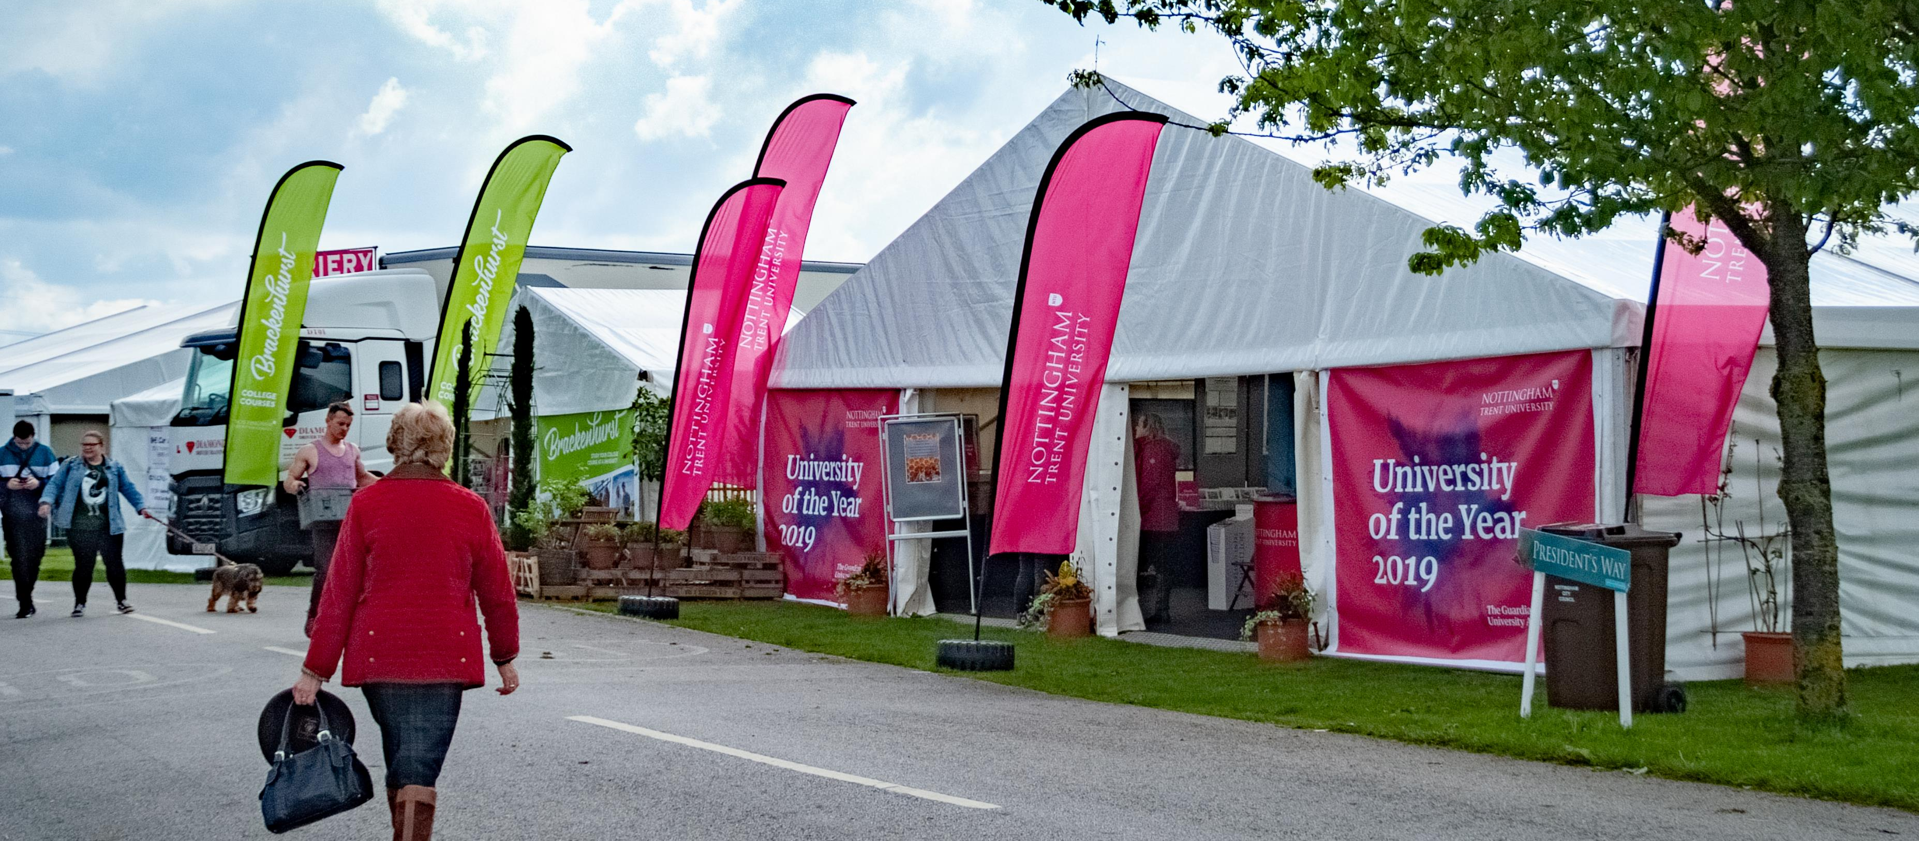
SECTION 4 – SET UP AND DISMANTLING OF TRADE STANDS
4.1 Stand Set up
Set Up Times:
Thursday, 12th May 12:00 – 19:00
Friday, 13th May 8:00– 19:00
Saturday, 14th May 06:30– 08:30
All exhibitors must set up their stands and be open by 08:30 on show day.
There is a no vehicle movement policy from 08:30 until the close of the show.
4.2 Encroachment
Encroachment onto any adjoining stand will not be tolerated.
4.3 Mobile Units
Exhibitors with large mobile units should arrange to have these in position by Thursday 12 May. This is especially important when it is necessary to encroach on adjoining stand space to maneuver the unit into position. No articulated units may be sited during the hours of darkness.
4.4 Delivery to Stands
Goods and packages should not be sent to the Showground unless there is a representative of the trade stand to receive them.
4.5 Time of Dismantling / Removal of Trade Stands
NO PART OF A STAND MAY BE CLOSED OR DISMANTLED UNTIL 18:00 hours ON SATURDAY 14 MAY. Collecting vehicles will be allowed in after this time once the public have left site and it is declared safe to do so. Announcements will be made over the PA system to inform exhibitors when vehicle movement can commence.

Slide 13
Newark & Nottinghamshire Agricultural Society
Organisers of the:
Nottinghamshire County Show
Newark & Nottinghamshire Agricultural Society is a registered charity dedicated to promote, celebrate and champion agriculture across the Midlands region.
If you would like to support our work, find out more about the benefits of becoming a member.
www.nottinghamshirecountyshow.com/membership/
Newark & Nottinghamshire Agricultural Society
Newark Showground, Lincoln Road, Newark, Nottinghamshire NG24 2NY
Tel: 01636 705796.
CONTACT DETAILS
Francesca Hayes
Trade Stand Sales & Sponsorship Officer
Email: francesca.hayes@newarkshowground.com
Elizabeth Halsall
Events and Development Manager
Email: elizabeth.halsall@newarkshowground.com
Website:
www.nottinghamshirecountyshow.com
Twitter: @nottscountyshow
Facebook: @NottinghamshireCountyShow

