Slide 1


Farm Show 2025 Stand Packages
whitespacexpo.com

Slide 2
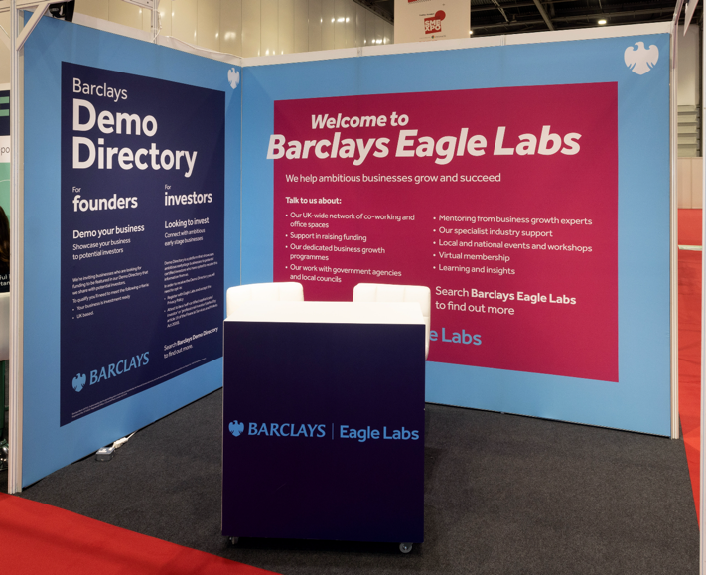
Package A:
Olympus Chair Package (x2 chairs) £206.00 + VAT
Lockable Cabinet:
With Graphic £160.80 + VAT
Without Graphic £88.80 + VAT
Fabric £196.80 + VAT per linear metre
Carpet £10.40 + VAT per square metre
2

Slide 3
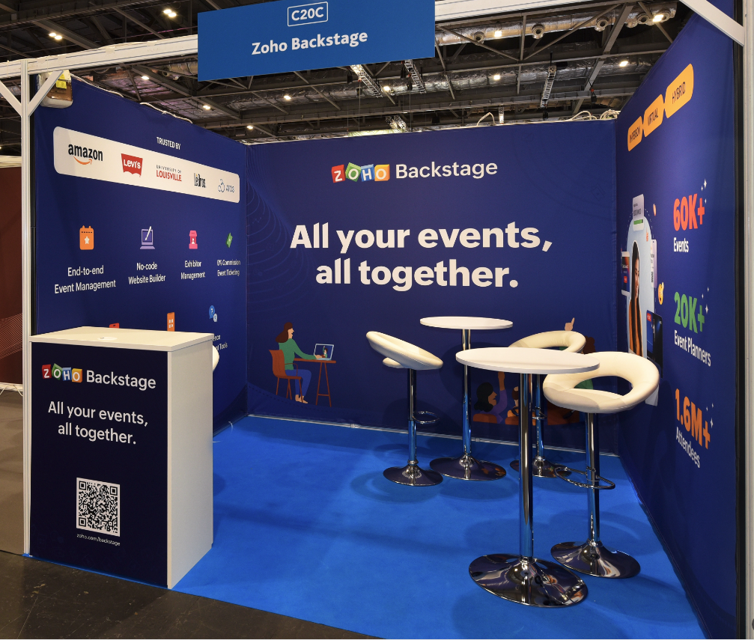
Package B:
Hi Stool Package (x2 stools) £96.10 + VAT
Lockable Cabinet:
With Graphic £160.80 + VAT
Without Graphic £88.80 + VAT
Fabric £196.80 + VAT per linear metre
3

Slide 4
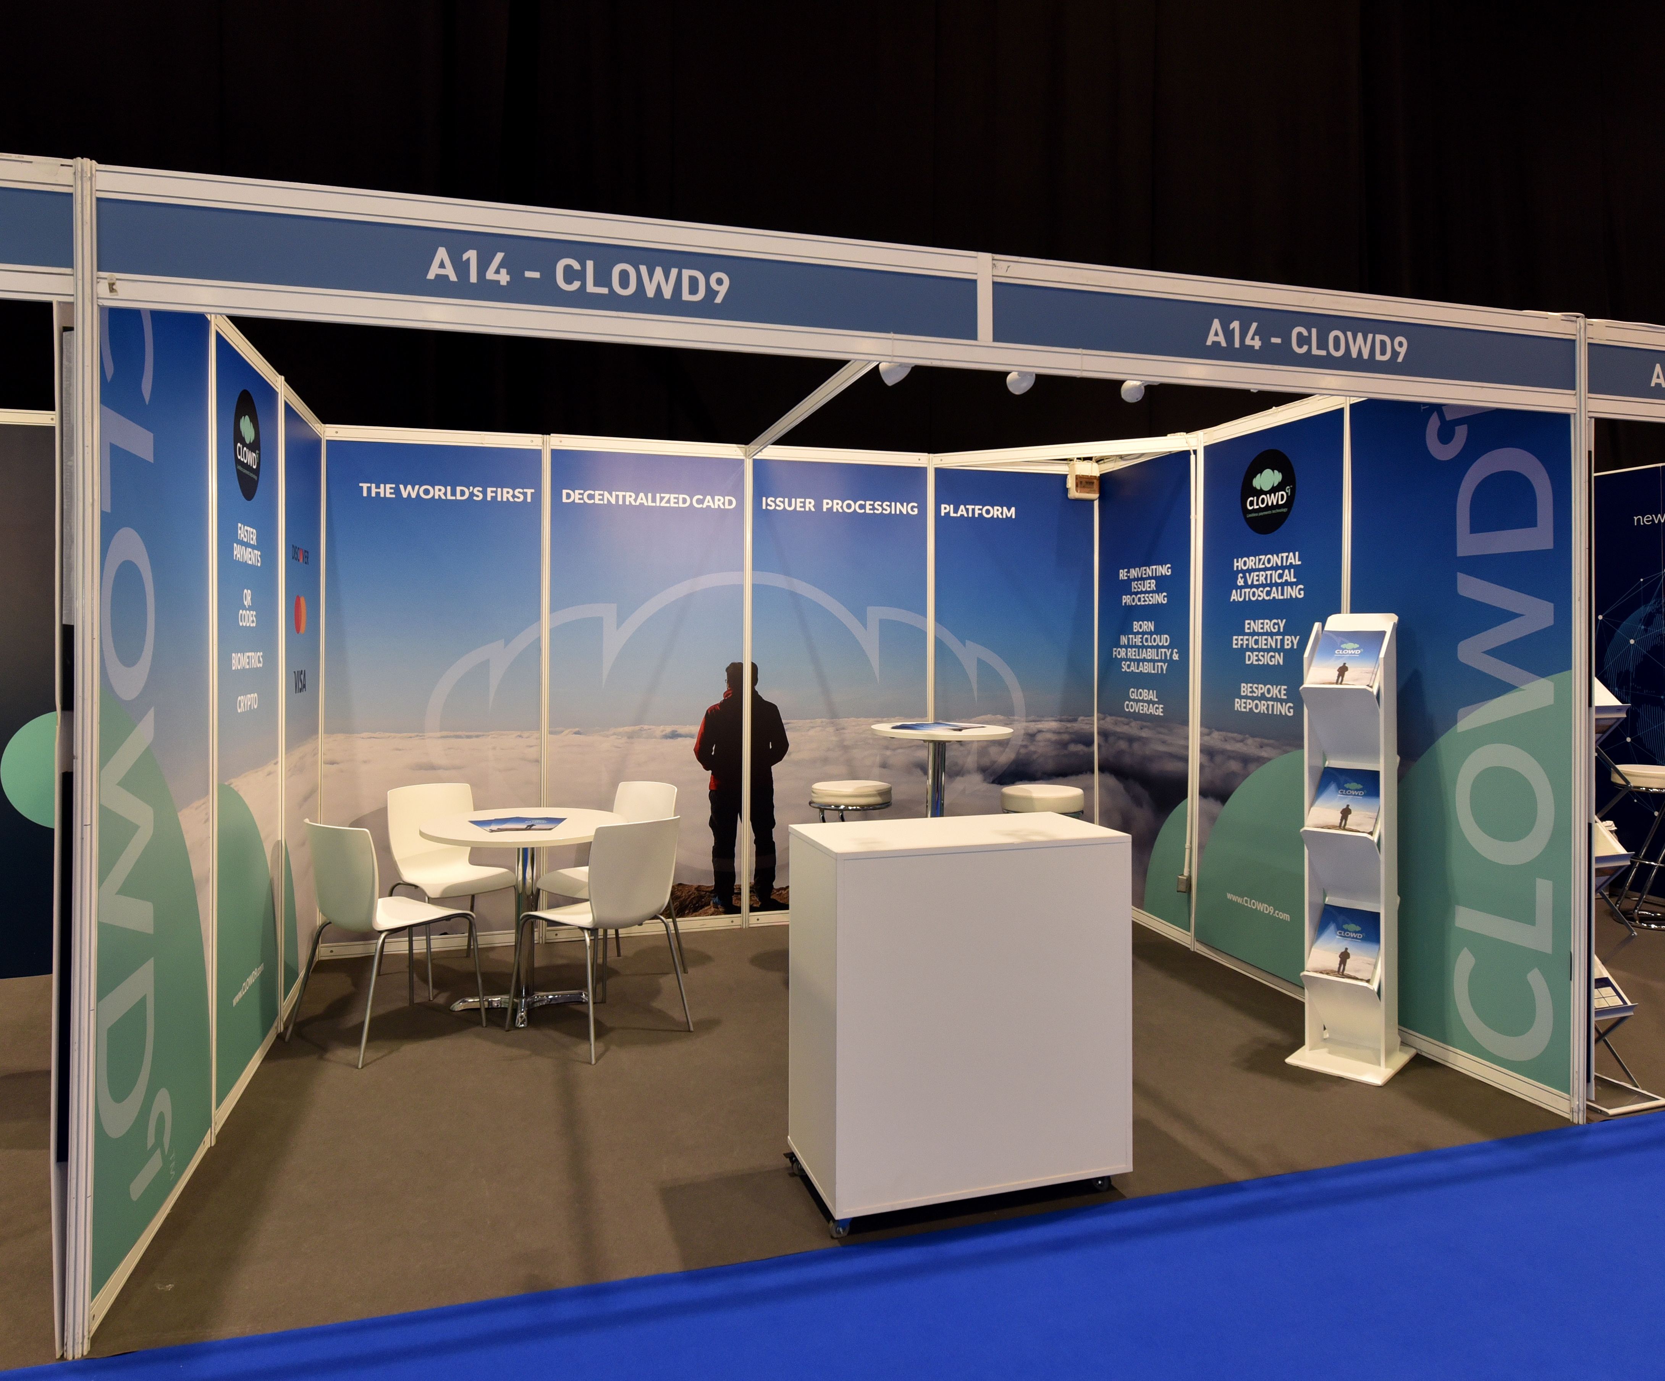
Package C:
Olympus Chair Package (x2 chairs) £206.00 + VAT
Foamex Panels £140.80 + VAT per panel
Carpet £10.40 + VAT per square metre
4

Slide 5
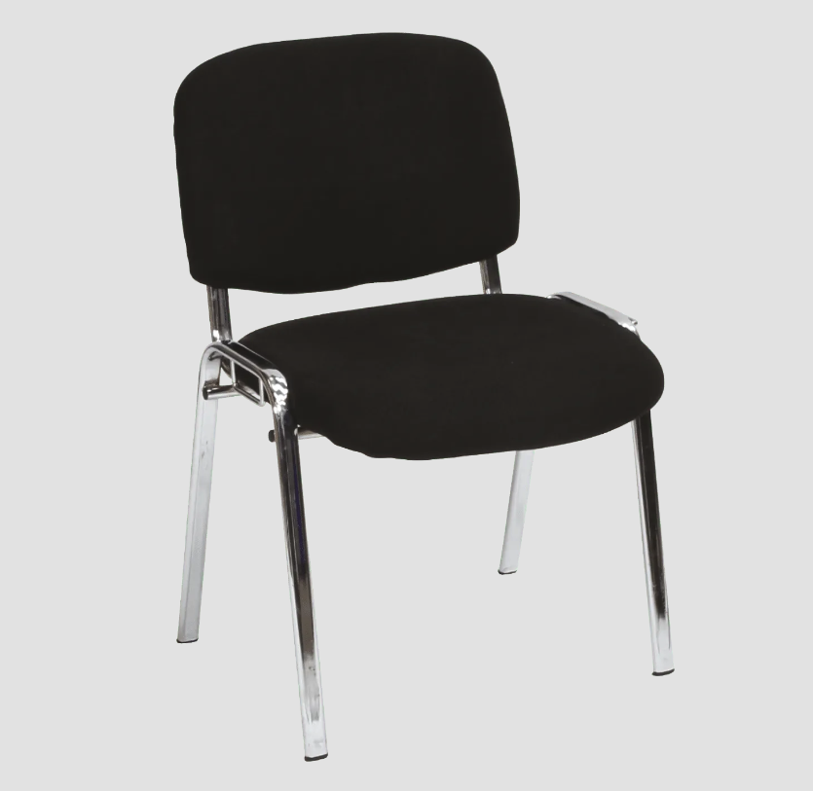
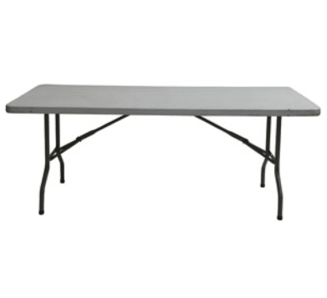
Package D:
Foamex Panels £140.80 + VAT per panel
4ft Utility Table £20.91 + VAT
x4 Chairs £22.00 + VAT per chair
Carpet £10.40 + VAT per square metre
5

Slide 6


Package E:
Lockable Cabinet:
With Graphic £160.80 + VAT
Without Graphic £88.80 + VAT
Olympus Chair Package (x2 chairs) £206.00 + VAT
6

Slide 7
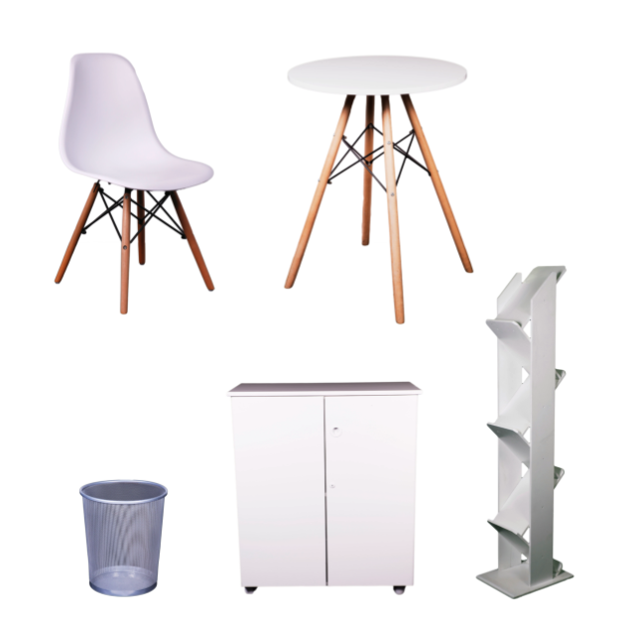
Package F:
Fabric £196.80 + VAT per linear metre
Carpet £10.40 + VAT per square metre
Package A:
x2 Chairs £168.00 + VAT
x4 Chairs £190.00 + VAT
7

Slide 8
If you need any additional information, please reach out -
Contact
info@whitespacexpo.com
+44 (0)75 7203 3913
Address
Whitespace XPO
320 Western Road
London
SW19 2QA
whitespacexpo.com

